Slide 1
Independent Project
Shivam garg
Vibhor rawal

Slide 2
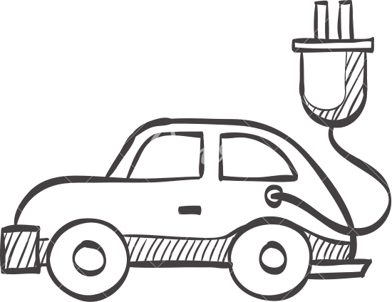

Remote Control Car
Utilising android app studio and arduino

Slide 3
Android App
The app with be used as a remote control for the R/C car.
Front end:
The front end will constitute the first layout as a connection establishment and testing with R/C car.
The second layout will showcase the remote interface to control the car.
Back end:
The connections will take place via Bluetooth to deliver the commands controlling the R/C car.

Slide 4
R/C car
The hardware side of the development would consist of a Bluetooth module(HC-05) working on Serial Communication and a development board, namely Arduino.
The Arduino board would drive the motors using principle of double-pole double-throw.
Further development and progress will be integrated as the project evolves.

Slide 5
To be continued…….

